Slide 1







Franchise Partnership Program
Nourishing Lives, One Meal at a Time • Authentic, Affordable Indian Thalis, Unlimited Meals, Daily Tiffins & Event Catering

Slide 2

The Untapped Demand
Bridging the wide gap between expensive specialty dining and everyday Filipino affordability through high-value Indian meal sets.

Slide 3


Market Gap & The Simhika Solution
The Current Market Gap
The Simhika Solution
Overpriced Dining: Most Indian restaurants in Metro Manila charge ₱450–₱900+ per main dish, limiting access for everyday consumers.
Accessible Everyday Pricing: Value-packed mini thalis from ₱180–₱220 and full unlimited sets from ₱299, maximizing volume.
Lack of Quick Combos: Office workers and students lack fast, affordable, pre-portioned meal sets during peak lunch hours.
Cultural Alignment: Tapping into the Filipino love for "unlimited rice & gravies," offering exceptional perceived dining value.
Fragmented Catering: High demand for hygienic vegetarian, vegan, and traditional halal-friendly meals without accessible suppliers.
Multi-Channel Revenue: Daily dine-in turnover backed by corporate tiffin lunch subscriptions and bulk party catering.

Slide 4

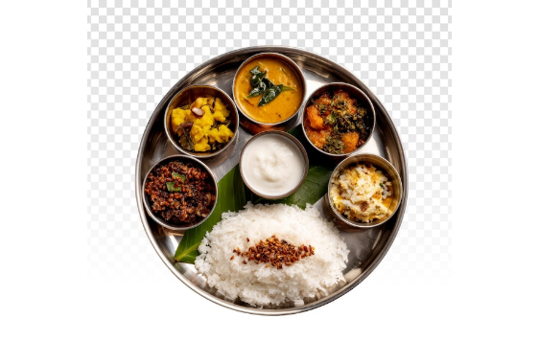
Authentic Regional Indian Thalis
Simhika Kitchen celebrates the rich culinary heritage of India with standardized authentic recipes crafted for high kitchen efficiency:
•
North Indian Thalis: Rich Dal Makhani, Paneer Butter Masala, fresh tandoor chapatis, jeera rice, and gulab jamun.
•
South Indian Feasts: Aromatic Sambar, pepper Rasam, mixed vegetable Poriyal, curd rice, and crisp appalam papads.
•
Unlimited Meals Model: Unlimited hot rice, fresh rotis, and aromatic gravies driving massive repeat footfall.
•
Healthy & Homemade: Cooked with premium whole spices, authentic traditional methods, low oil, and zero artificial colors.

Slide 5









Four Resilient Revenue Streams
Thalis & Unlimited Meals
Monthly Tiffin Subscriptions
Corporate & Event Catering
High-turnover dine-in sets and express mall trays designed for fast throughput during lunch and dinner rushes.
Recurring weekday lunchbox deliveries for BPO professionals, students, and expat communities across business districts.
High-margin bulk orders for office town halls, embassy events, birthdays, weddings, and cultural celebrations.

Slide 6
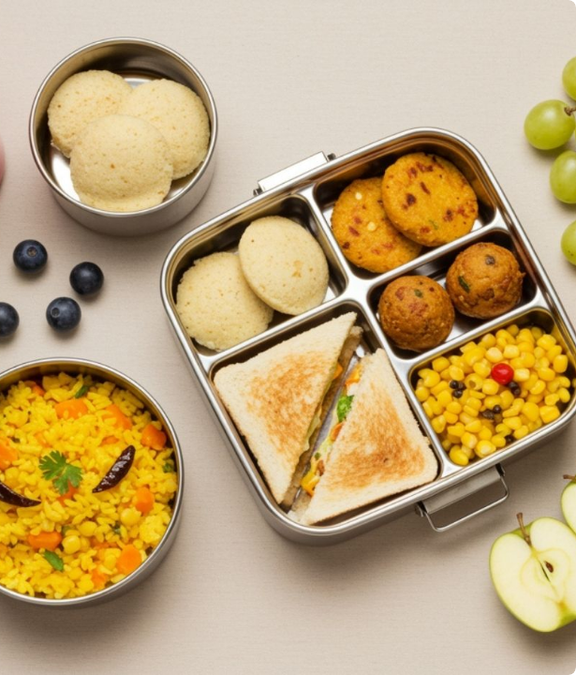
Corporate Tiffin & Catering
Predictable Recurring Revenue
Our subscription tiffin packages provide franchisees with predictable upfront monthly cash flow. Pre-scheduled delivery routes allow central kitchens to batch-cook with zero ingredient wastage.
Corporate accounts and bulk event packages deliver substantial profit margins with zero dining-room overhead.

Slide 7
Franchise Investment Models
Model Type | Capital Outlay | Min. Monthly Sales | Guaranteed / Est. ROI | Strategic Operational Focus
1. Cloud Kitchen Setup | ₱500,000 | ₱200,000 | 30% per annum | Delivery, online apps (Grab/Foodpanda), and BPO tiffin boxes.
2. Mall Takeout Kiosk | ₱1,000,000 | ₱500,000 | 20% – 30% per annum | High footfall mall food courts, quick grab-and-go mini thalis.
3. Full Restaurant Setup | ₱1,500,000 | ₱1,000,000 | 25% per annum | Complete sit-down dining, unlimited thali feasts, family banquets.

Slide 8
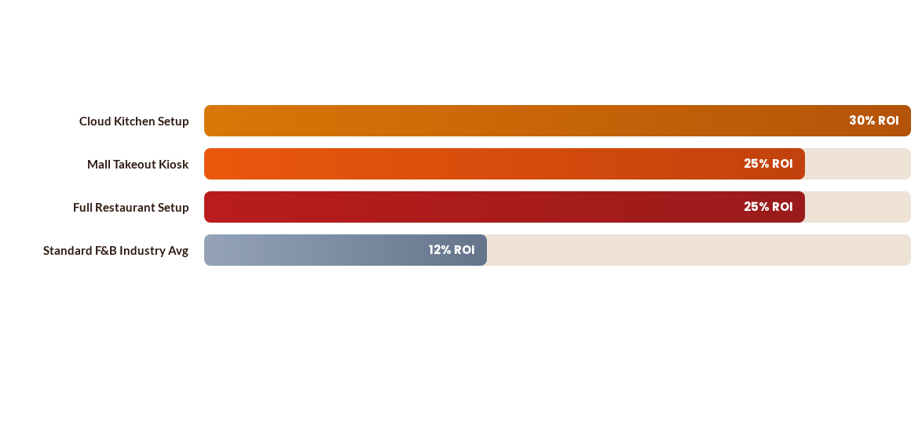
Projected Annual Net ROI
Simhika Kitchen's low food waste framework, centralized spice procurement, and high-frequency meal subscriptions double standard F&B investment returns.

Slide 9

High-Yield F&B Investment
₱500K
Low Capital, Faster Breakeven
Our entry-level cloud kitchen setup allows prospective entrepreneurs and seasoned franchisees to enter the lucrative Philippine food service sector with minimal risk.
Entry Level Investment
With guaranteed annual return targets of up to 30% and an estimated capital recovery timeline within 18 to 24 months, Simhika Kitchen delivers proven financial sustainability.

Slide 10


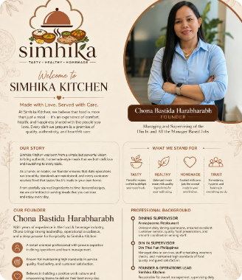

Meet Our Founder & Operations Lead
Proven Leadership in Philippine F&B
Bringing extensive experience in restaurant management, operational rigor, and heartfelt customer hospitality:
•
Dining Supervisor at Annapoorna Restaurant: Directed floor dining service, staff coordination, presentation aesthetics, and guest relations for authentic Indian cuisine.
•
Din-In Supervisor at Din Tai Fung Philippines: Managed shift scheduling, inventory tracking, and maintained world-class standards of food safety, cleanliness, and speed.
•
Founder & Operations Lead at Simhika Kitchen: Directly supervises daily kitchen performance, franchisee onboarding SOPs, and menu execution across all units.
"Made with Love. Served with Care. We believe food is an experience of comfort, health, and genuine happiness shared with the people you love."
Chona Bastida Harabharabh
FOUNDER & OPERATIONS LEAD

Slide 11
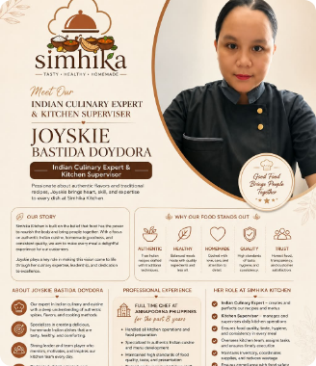
Indian Culinary Expert & Chef
8+ Years Master Indian Kitchen Authority
Master of authentic regional spices, traditional gravies, tandoor recipes, and high-efficiency commercial kitchen systems:
•
Full-Time Chef at Annapoorna Philippines (Past 8 Years): Led high-volume Indian kitchen operations, traditional spice blending, and authentic curry preparations for nearly a decade.
•
Recipe & Gravy Standardization: Developed proprietary master gravies and measured spice formulas that allow franchisees to reproduce authentic taste without hiring master chefs.
•
Quality, Hygiene & Waste Management: Enforces strict food safety compliance, tight inventory checks, and portion control to protect franchisee profit margins.
"Good Food Brings People Together. We craft authentic Indian dishes with healthy ingredients, less oil, and home-style integrity."
Joyskie Bastida Doydora
CULINARY EXPERT & KITCHEN SUPERVISOR

Slide 12
End-To-End Partner Support
Turnkey Kitchen SOPs & Master Gravies: Foolproof recipe manuals and pre-measured spice blends ensure uniform taste without costly master chefs.
Central Supply Chain & Sourcing: Direct bulk sourcing of authentic Indian spices, Basmati rice, pulses, and packaging at discounted wholesale rates.
Delivery App & Marketing Integration: Seamless onboarding onto GrabFood and Foodpanda with local geotargeted promotional campaigns.
Comprehensive Staff Training: Intensive hands-on training covering prep speed, portions, food hygiene, inventory control, and customer care.

Slide 13

Invest Today. Earn Tomorrow.
Be a Part of the Simhika Kitchen Family
Join the fastest-growing authentic Indian dining concept in the Philippines. Together, let's bring healthy, delicious, and affordable thalis to millions of diners.
franchise@simhikakitchen.ph
+63 (02) 8XXX-XXXX / Mobile Inquiry
Metro Manila, Philippines

Slide 14


Image Sources
https://img.magnific.com/free-psd/traditional-indian-thali-meal-with-rice-curries-yogurt-steel-plate_84443-94335.jpg
Source: www.magnific.com
https://restaurantindia.s3.ap-south-1.amazonaws.com/s3fs-public/2025-12/hew8ifhfed.jpg
Source: www.restaurantindia.in

